Slide 1

Managing Employee Performance and Satisfaction Data.
Member 1: SARASWATHY. S
Member 2: PRAVEENKUMAR. S

Slide 2

PROJECT OBJECTIVE:
The objective of this project is to design and implement a comprehensive SQL database system for managing employee performance and satisfaction data. This system will facilitate efficient data storage, retrieval, and analysis to support HR decision-making processes.

Slide 3
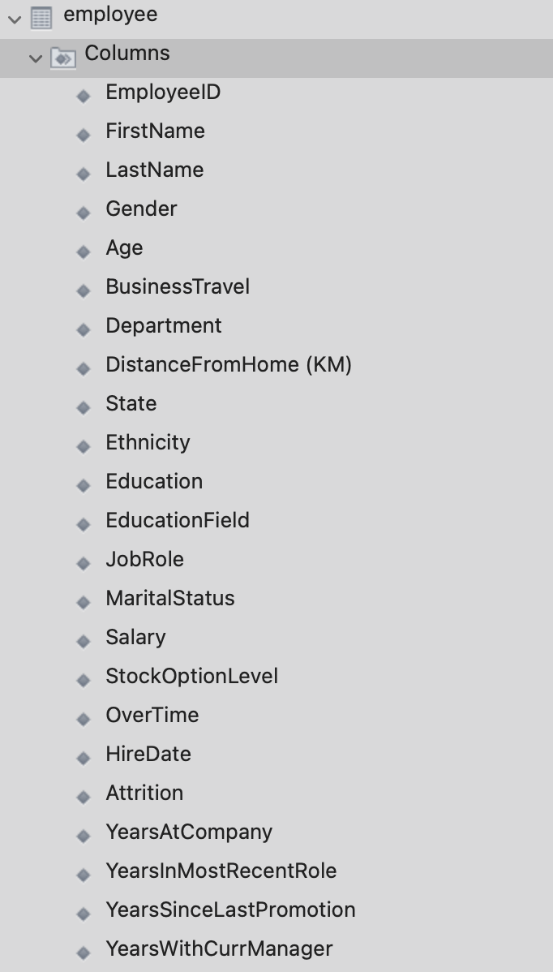
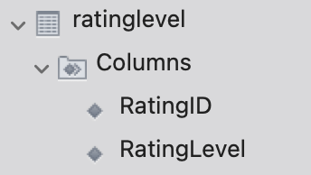
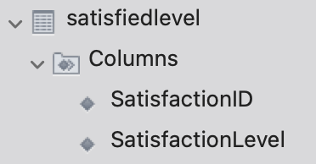
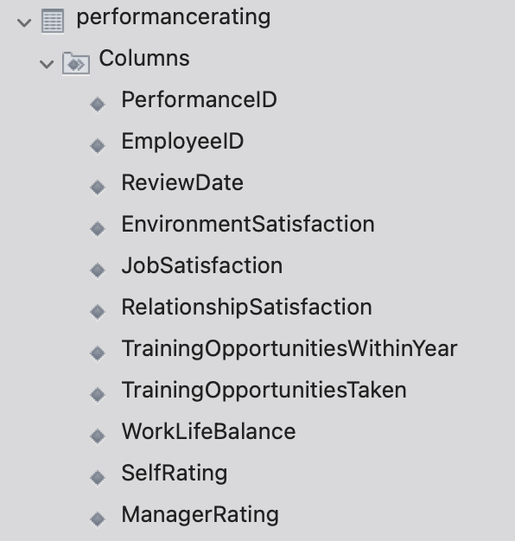
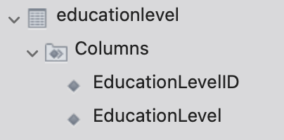

Slide 4
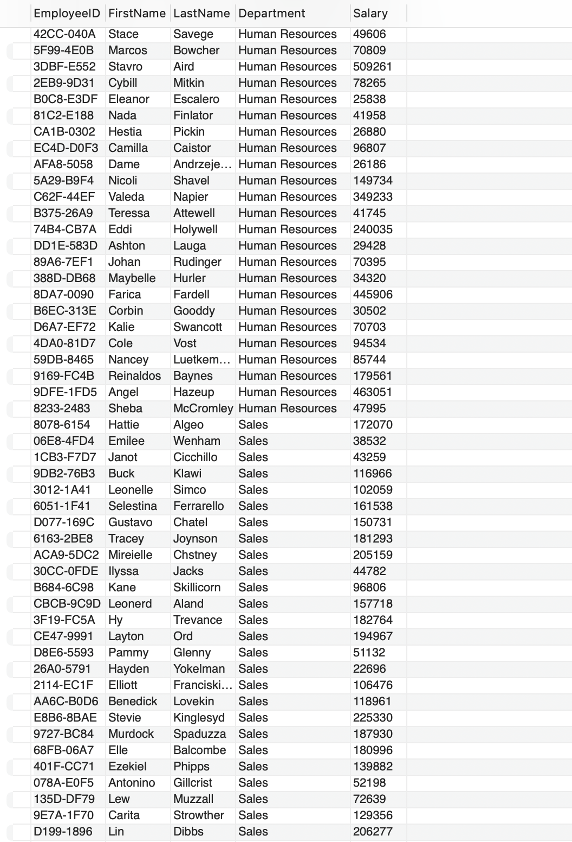
Write a sql code to arrange department order wise listing all employess
SELECT EmployeeID, FirstName, LastName, Department, Salary
FROM Employee
ORDER BY Department ASC;
Notes:
Before moving on to query let me tell that…..In this proj All the query are taken based on hr perspective!!!!……In an org the raw data will mostly will be mixed and un uniformed. In order to arrange this can be used ORDER BY clause is used to sort the results.

Slide 5
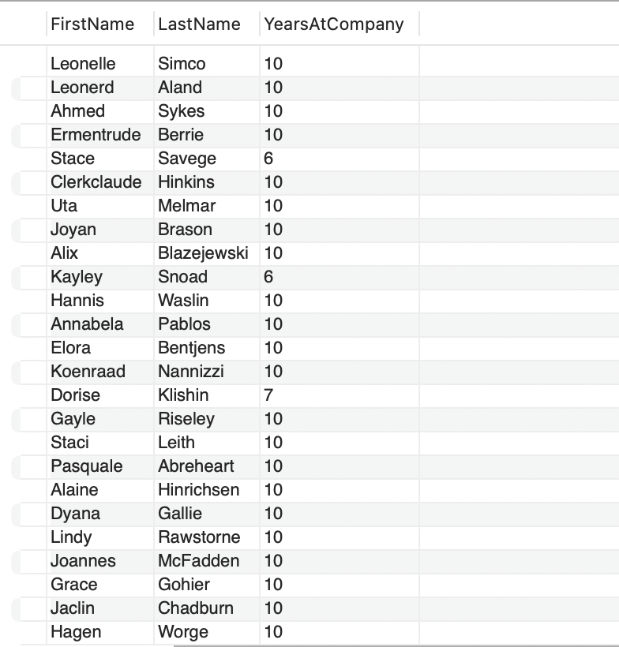
Write a SQL command to List employees who have been with the company for more than 5 years.
SELECT FirstName, LastName, YearsAtCompany
FROM Employee
WHERE YearsAtCompany > 5;
Notes:
WHERE clause is used to filter the results.

Slide 6
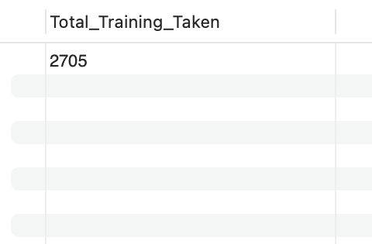
Write a SQL command to calculate the total number of training opportunities taken by all employees.
SELECT SUM(TrainingOpportunitiesTaken) AS Total_Training_Taken
FROM PerformanceRating;
Notes:
In a org every year the hr dept will arrange training program in order to leverage the growth of technology to the employee…. In order to find wether training opportunities is benefitial for employees

Slide 7
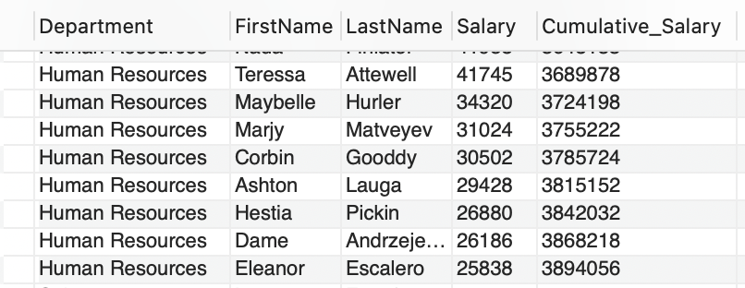
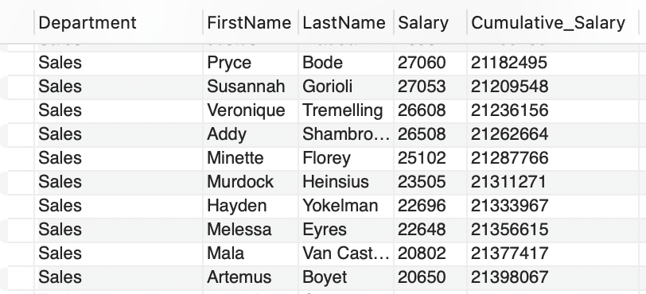
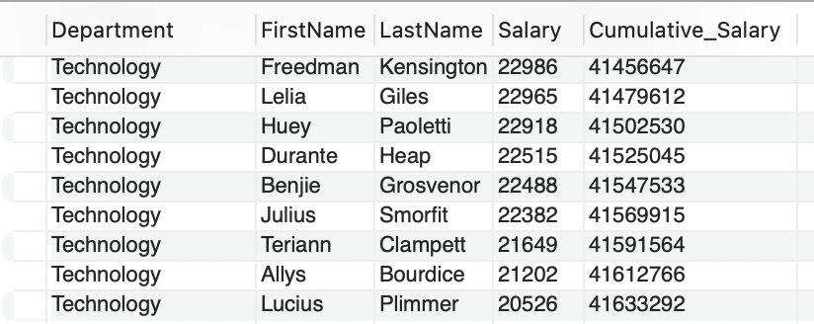
Write a SQL command to calculate the cumulative salary for each department.
SELECT Department, FirstName, LastName, Salary,
SUM(Salary) OVER (PARTITION BY Department ORDER BY Salary DESC) AS Cumulative_Salary
FROM Employee;
Notes:
Is to find the total salary required for each dept …. This is useful for generating a running total of salaries within each department, and also helps in managing funding

Slide 8
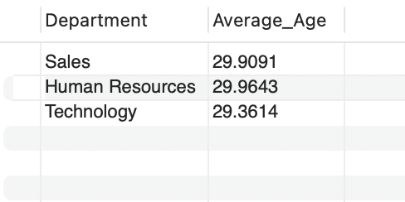
Write a SQL command to find the average age of employees in each department.
SELECT Department, AVG(Age) AS Average_Age
FROM Employee
GROUP BY Department;
Notes:
hr wants to know the average age of an employee in each department…. If sales has more ager person, he cannot work in field.. then the org should consider new vacancy to hire a lower age employee

Slide 9
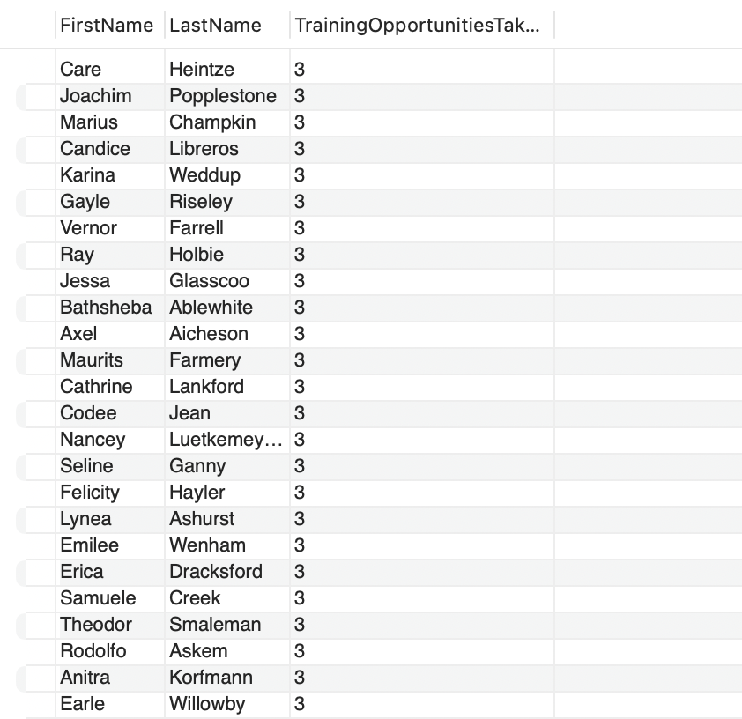
Write a SQL command to find employees who have taken more than 2 training opportunities within a year.
SELECT e.FirstName, e.LastName, p.TrainingOpportunitiesTaken
FROM Employee e
JOIN PerformanceRating p ON e.EmployeeId = p.EmployeeId
WHERE p.TrainingOpportunitiesTaken > 2;

Slide 10
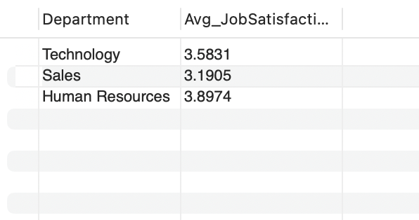
Write a SQL command to calculate the average job satisfaction for each department, considering only employees with more than 5 years at the company.
SELECT e.Department, AVG(p.JobSatisfaction) AS Avg_JobSatisfaction
FROM Employee e
JOIN PerformanceRating p ON e.EmployeeId = p.EmployeeId
WHERE e.YearsAtCompany > 5
GROUP BY e.Department;
Notes:
Is used to calculate the average job satisfaction for long-tenured employees in each department.

Slide 11
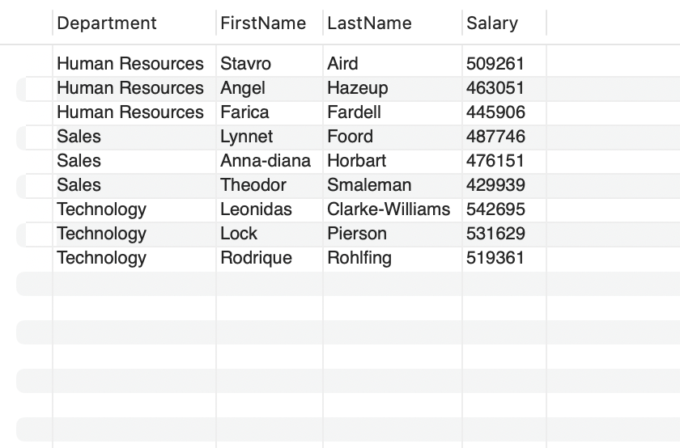
Write a SQL command to find the top 3 highest-paid employees in each department.
SELECT Department, FirstName, LastName, Salary
FROM (
SELECT Department, FirstName, LastName, Salary,
ROW_NUMBER() OVER (PARTITION BY Department ORDER BY Salary DESC) AS row_rank
FROM Employee
) AS ranked
WHERE row_rank <= 3;
Notes:
Over…… This can be useful for generating a report on salary distribution among top employees in different departments

Slide 12
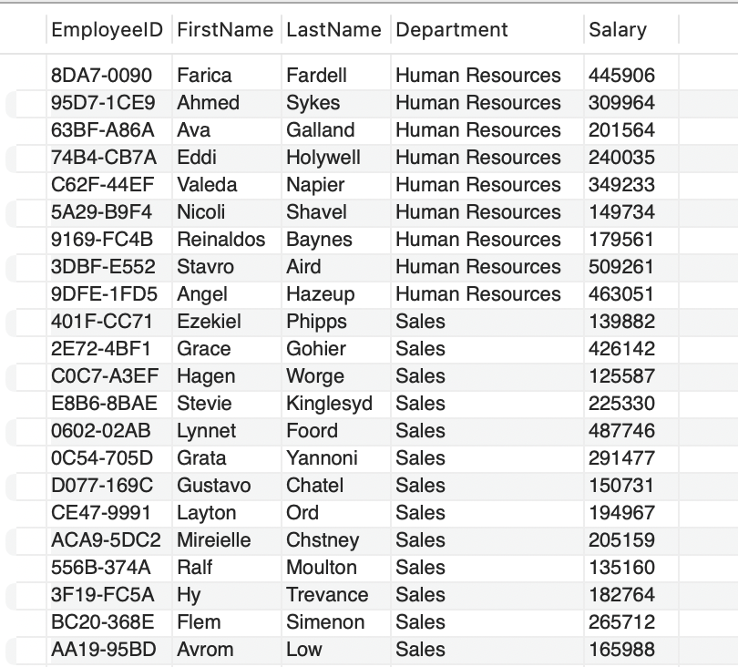
Write a SQL command to find employees who have a higher salary than the average salary of their department.
SELECT EmployeeID, FirstName, LastName, Department, Salary
FROM Employee e
WHERE Salary > (
SELECT AVG(Salary)
FROM Employee
WHERE Department = e.Department
)
ORDER BY Department;

Slide 13
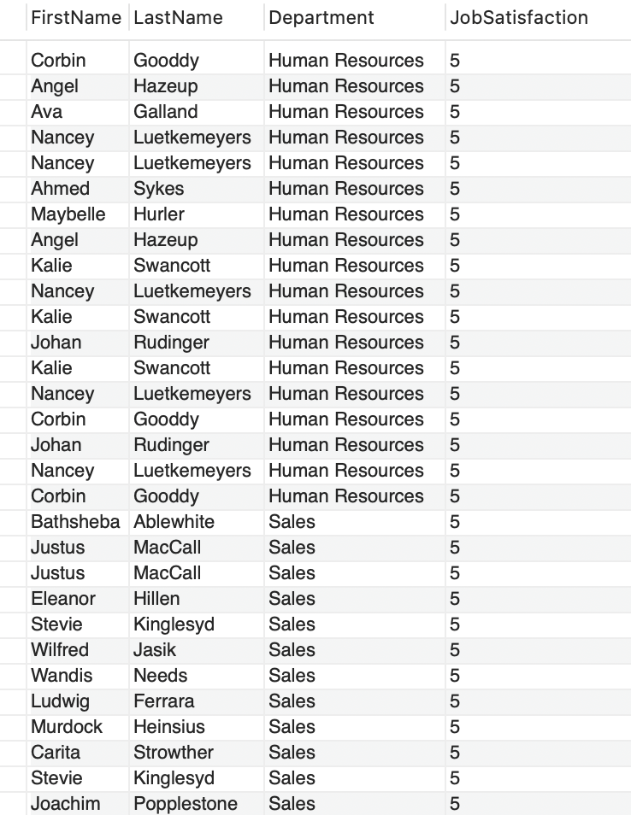
Write a SQL command to list employees who have the highest job satisfaction in their department.
SELECT e.FirstName, e.LastName, e.Department, p.JobSatisfaction
FROM Employee e
JOIN PerformanceRating p ON e.EmployeeId = p.EmployeeId
WHERE p.JobSatisfaction = (
SELECT MAX(p2.JobSatisfaction)
FROM PerformanceRating p2
JOIN Employee e2 ON p2.EmployeeId = e2.EmployeeId
WHERE e2.Department = e.Department )
ORDER BY Department;

Slide 14
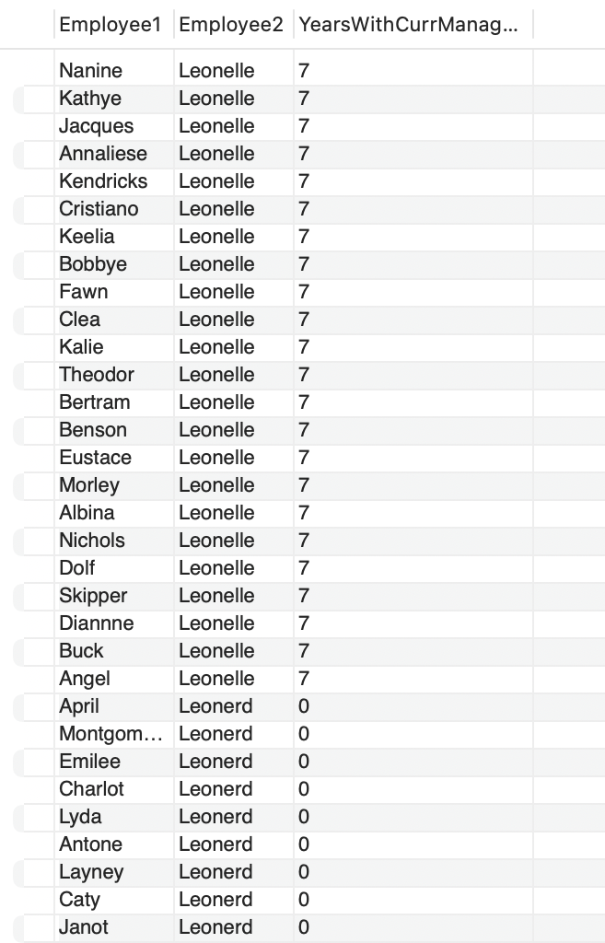
Write a query to list all employees who share the same manager. Use a self join on the Employee table to find employees with the same Years With Current Manager.
SELECT e1.FirstName AS Employee1, e2.FirstName AS Employee2, e1.YearsWithCurrManager
FROM Employee e1
INNER JOIN Employee e2 ON e1.YearsWithCurrManager = e2.YearsWithCurrManager
WHERE e1.EmployeeID != e2.EmployeeID;

Slide 15
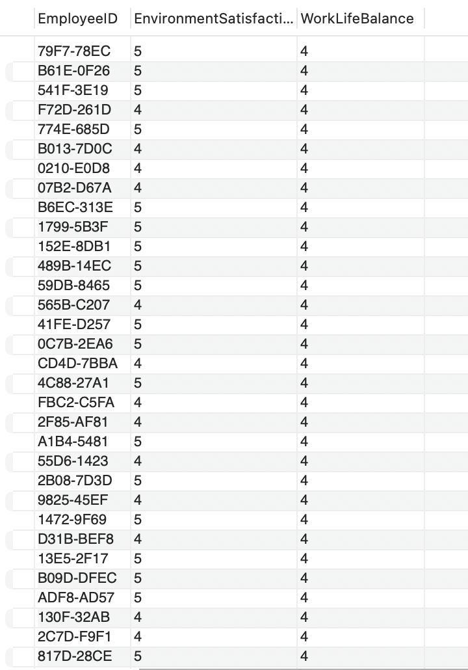
Write a query to join Performance Rating and Satisfied Level tables on Environment Satisfaction and display the employees who have both Environment Satisfaction of 4 and above, and Work Life Balance of 4.
SELECT p.EmployeeID, p.EnvironmentSatisfaction, p.WorkLifeBalance
FROM PerformanceRating p
JOIN SatisfiedLevel s
ON p.EnvironmentSatisfaction = s.SatisfactionID
WHERE p.EnvironmentSatisfaction >= 4 AND p.WorkLifeBalance = 4;

Slide 16
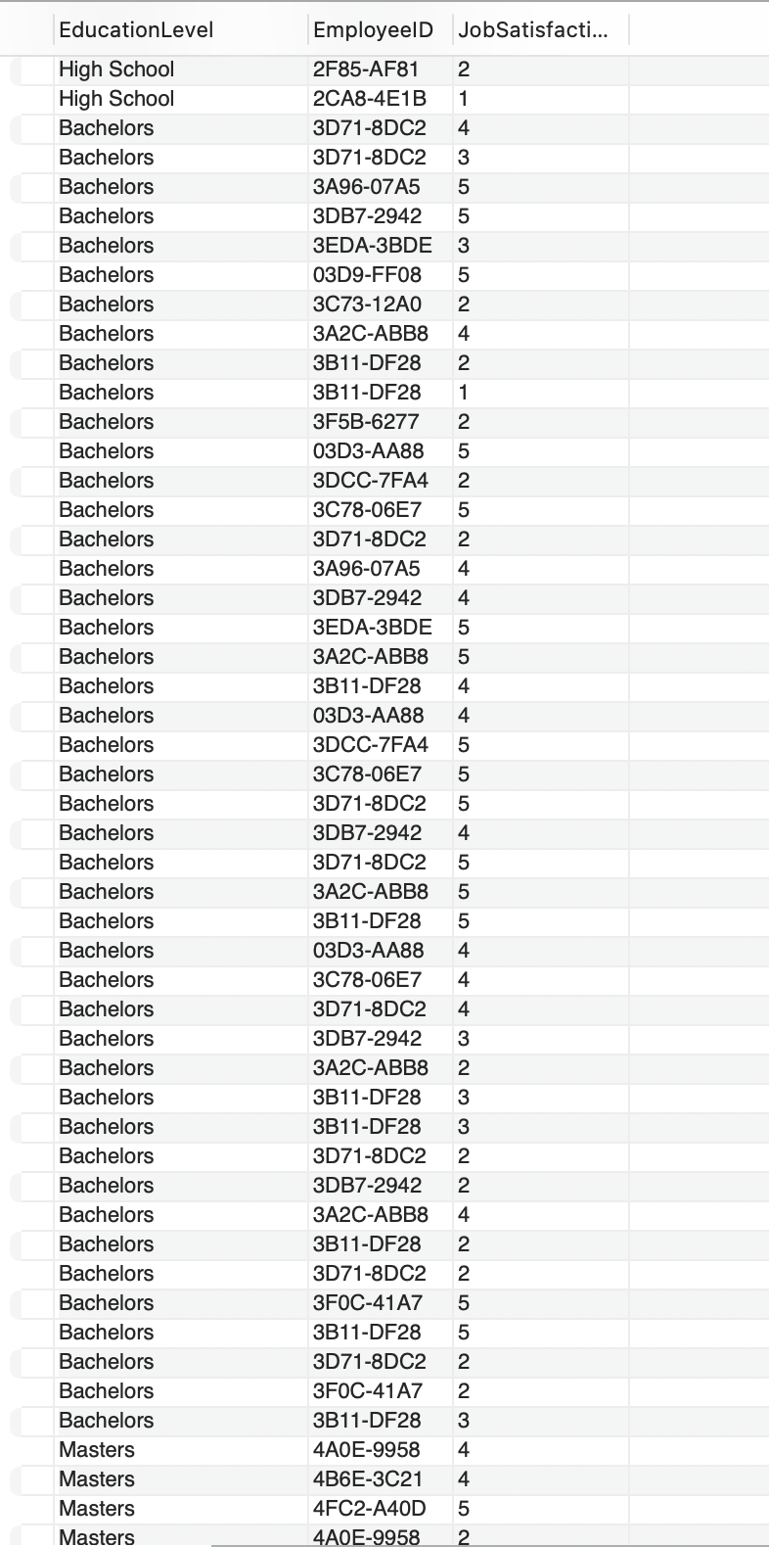
Write a query using a left outer join to display all education levels from the Education Level table and their corresponding Employee ID from the Performance Rating table, if available.
SELECT e.EducationLevel, p.EmployeeID, p.JobSatisfaction
FROM EducationLevel e
LEFT JOIN PerformanceRating p
ON e.EducationLevelID = p.EmployeeID;

Slide 17
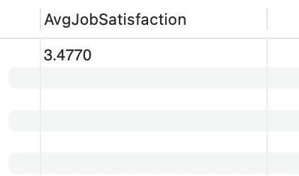
Write a stored procedure that calculates the average Job Satisfaction for all employees from the Performance Rating table.
DELIMITER //
CREATE PROCEDURE Average ()
BEGIN
SELECT AVG(JobSatisfaction) AS AvgJobSatisfaction
FROM PerformanceRating;
END //
DELIMITER ;
CALL Average();

Slide 18
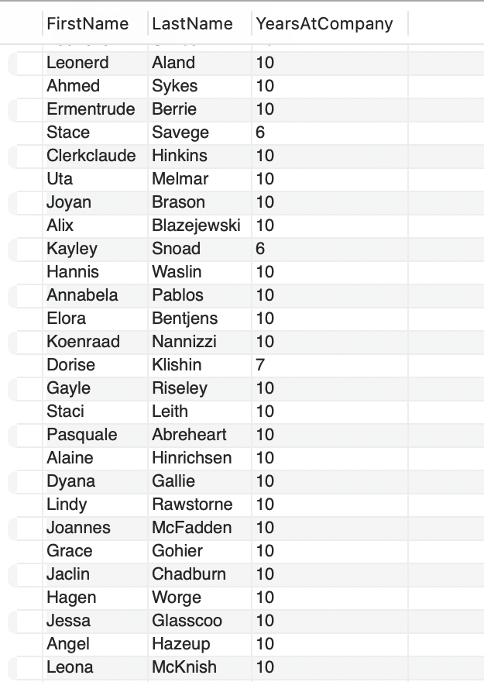
Write a query using a CTE to retrieve the First Name, Last Name, and Years At Company for all employees who have worked more than 5 years.
WITH Emp AS (
SELECT FirstName, LastName, YearsAtCompany
FROM Employee
WHERE YearsAtCompany > 5
)
SELECT * FROM Emp;

Slide 19
CONCLUSION:
The successful design and implementation of the comprehensive SQL database system for managing employee performance and satisfaction data have significantly enhanced the HR department’s ability to make informed decisions.

Slide 20

Any Questions or
Suggestion

Slide 21

THANK YOU

